Slide 1
Soft Skills for Student Success
in a Precalculus Corequisite Course
Johanna M Debrecht
Northern Virginia CC
jdebrecht@nvcc.edu

Slide 2
Overview
Time Management
Metacognition
Study Skills
Problem Solving & Resourcefulness
Grit
Communication & Interpersonal Skills
FOCUS ON LEARNING — NOT GRADES

Slide 3
Time management
  How many hours per week are you committed to right now?
  Each unit represents 2-4 hours of just homework/studying per week, or 3-5 including class time.
    The following classes EAT TIME; plan on 4 hours: math, chemistry, anatomy, physics, computer science programming, foreign language.
  How many hours a week do you work?
  Do you have responsibility for young children? Grandparents? Other relatives with serious illnesses?
  How long does it take you to commute to school? Work?

Slide 4
Time management
  Do you belong to sports teams? Other clubs?
  Do you have a significant other?
    Do you want to keep them?
  How many hours of sleep do you need per night?
  Figure on 2-3 hours per day of eating and meal preparation.
  How many hours does it add up to?

Slide 5
Time management
You haven’t gotten gas for the car, or fed the dog, or paid the bills, or hung out with friends.
You haven’t done any laundry, or shopping, or showering, or brushing your teeth.
And there are only 168 hours in a week.
Don’t get too smug.

Slide 6

Why talk about metacognition?
Help students identify and close “the gap”
current behavior current grades
effective behavior desired grades

Slide 7

Metacognition
  The ability to think about one’s thinking and to evaluate and change what one is doing and thinking during an experience.
  Reflective learning, how does this relate to what I already know
    What’s the next step studying
    Digging deeper
  Elastic intelligence
  Goal-setting and evaluation of progress
Image retrieved from https://www.google.com/imgres?imgurl=https://www.edutopia.org/sites/default/files/styles/share_image/public/cover_media/wilson-metacognition-460x345.jpg%3Fitok%3DtlaonWNw&imgrefurl=https://www.edutopia.org/blog/metacognition-gift-that-keeps-giving-donna-wilson-marcus-conyers&h=345&w=460&tbnid=959uJmqaOpHIsM:&tbnh=71&tbnw=94&usg=__czb9c4WTOElWmBBhRqV2Z7CfF0U=&vet=10ahUKEwjkhPC6yqrXAhWC5yYKHf64CJgQ_B0ItQEwEw..i&docid=URfPyPxHJCJHuM&itg=1&sa=X&ved=0ahUKEwjkhPC6yqrXAhWC5yYKHf64CJgQ_B0ItQEwEw

Slide 8
Metacognition: Reflective learning
5 Top Strategies:
Ask questions about your thinking, look for patterns and identify the strategies you use
Be aware of the Habits of Mind that you use most and those which challenge you
Describe the steps you are taking to complete a task, use your mind’s voice, speak the process aloud, write the steps down
Become aware of barriers to effective thinking and avoid key tasks at such times (e.g., avoid distractions, don't make key decisions when you are tired)
Try alternative strategies to stimulate ideas. Draw a picture, type, speak your ideas, use a list or a mind map, use a different color, go for a walk.
Coutts, N. (2014). Metacognition: Thinking about your thinking. In RediQuest. Retrieved from http://www.rediquest.com/metacognition/

Slide 9
Reflective learning via Communication
Once-weekly response to open question: How do you study mathematics?
  Briefly describe week’s main ideas, concepts, or procedures.
  Describe their contributions to the course learning activities.
  Indicate their areas of difficulties.
  Suggest what they thought would help improve learning in the course.

Slide 10
Reflective learning via Communication
Draw one student’s name at random to summarize previous class day’s major concepts, theorems, definitions, procedures, w/o using notes.
  If stuck, class answers, again without notes.
Result: Everybody came on time to “quiz” each other on the previous day’s lesson.
This also helps the instructor pinpoint misconceptions early.

Slide 11
Reflective Learning via Communication: Professor guidelines
Teacher Guidelines for Implementing Student Reflection
Explain the meaning and rationale for student reflection practice.
Encourage students to continue daily reflection by randomly selecting a student to present.
Conduct weekly reflections on Mondays on paper provided to prevent cheating.
Keep a checklist of topics covered during each lesson. Make sure student presenting mentions all of them.
Comment on incomplete reflections (oral or written). Very poorly written reflections could be rewritten.
Teach students how to study and model good habits in the class. Recap & review.
Have a closed book/notes policy during oral presentations and written surveys.

Slide 12
The Daily 411:Guidelines
Before Oral Presentation
During Oral Presentation
After Oral Presentation
Orient students to what’s expected by doing the first presentation yourself. (Caveat: it’s a recap, not a reteach.)
Decide ahead how much detail you want. Be consistent in how you present main ideas in class. (Ex. All on left board.)
Prepare rubric to record and grade students’ oral presentations.
Remind students to communicate clearly.
Remind students you are taking notes on what they say or do.
Observe & listen during presentations.
Record student’s statements, use of diagrams & graphs, & confidence.
At end, ask probing questions for clarification and understanding.
Correct misconceptions.
Quickly complete any additional comments.
Finalize score after considering comments and notes.
Reassess instruction based on your findings.
SAMPLE

Slide 13
Metacognition: reflective learning: Next-Step studying
Reworking homework to study for an exam is too time-consuming and overwhelming for many students.
Homework isn’t about just about solving a problem; it should be your study guide for the exam.
Cover up all work but the problem.
What should you do first?
Uncover one line. Is that what you did? Why or why not?
What should you do next?
Repeat until you reach the end of the problem.
If you can accurately predict the next step all the way through, you are ready for that type of problem.

Slide 14



What do I do first?
$$3x+7=2\left(4x−9\right)−3$$
Dukesy68/sandbox. (2016). Man scratching head [Graphic]. Retrieved from https://commons.wikimedia.org/wiki/File:Man-scratching-head.gif

Slide 15
Multiply the 2 across!
$$3x+7=2\left(4x−9\right)−3$$
Dukesy68/sandbox. (2016). Man scratching head [Graphic]. Retrieved from https://commons.wikimedia.org/wiki/File:Man-scratching-head.gif

Slide 16

Is that what I did?
Yes!
$$3x+7=2\left(4x−9\right)−3$$
$$3x+7=8x−18−3$$
Dukesy68/sandbox. (2016). Man scratching head [Graphic]. Retrieved from https://commons.wikimedia.org/wiki/File:Man-scratching-head.gif

Slide 17
Now I should combine the -18 and -3.
$$3x+7=2\left(4x−9\right)−3$$
$$3x+7=8x−18−3$$
Dukesy68/sandbox. (2016). Man scratching head [Graphic]. Retrieved from https://commons.wikimedia.org/wiki/File:Man-scratching-head.gif

Slide 18

Did I?
Yes!
$$3x+7=2\left(4x−9\right)−3$$
$$3x+7=8x−18−3$$
$$3x+7=8x−21$$
Dukesy68/sandbox. (2016). Man scratching head [Graphic]. Retrieved from https://commons.wikimedia.org/wiki/File:Man-scratching-head.gif

Slide 19
Questions that encourage deeper thinking: Probe, not attack
What makes you say that?
What makes you think that?
How do you know that?
What makes you value that?
What has changed about your thinking?
What changed you mind?
What questions does that raise?
What question would a sceptic ask?
What evidence do you have?
What is the weak point in your argument?
Who would agree with you? - Who would disagree with you?
What do you still need to know?
What else?
What is missing?
Where do you go from here?
What part of the problem is left?
What are you certain about? Why?
What do you understand least?
Can you summarize what X said?
Is Y’s summary accurate, if not, what is inaccurate?
Coutts, N. (2014). Metacognition: Thinking about your thinking. In RediQuest. Retrieved from http://www.rediquest.com/metacognition/

Slide 20
5 more Questions to ask about your thinking
When you are making a decision, what internal conversations do you have?
What is your preferred situation for thinking?
What are your biases? What beliefs, values and perspectives influence your thinking?
Where do your ideas come from? What inspires your best ideas? What were you doing when you had that great idea?
What makes you think that?
Coutts, N. (2014). Metacognition: Thinking about your thinking. In RediQuest. Retrieved from http://www.rediquest.com/metacognition/

Slide 21
More Sample reflective questions
What’s the difference between studying and learning?
Do you think you are in study mode or learn mode?
What could I have done differently?
For which task would you study more?
A. Make an A on the test
B. Teach the material to the class

Slide 22
Mindset* Matters: Elastic Intelligence
Fixed Intelligence Mindset
Intelligence is static
You have a certain amount of it
Growth Intelligence Mindset
Intelligence can be developed
You can grow it with actions
* Dweck, C. (2008). Mindset: The new psychology of success. New York, NY: Ballantine Books.

Slide 23
Mindset determines reactions to…
Challenges – avoid vs. embrace
Obstacles – give up easily vs. persist
Tasks requiring effort – fruitless vs. path to mastery
Criticism – ignore vs. learn from
Success of Others – feel threatened by vs. find lessons and inspiration in

Slide 24
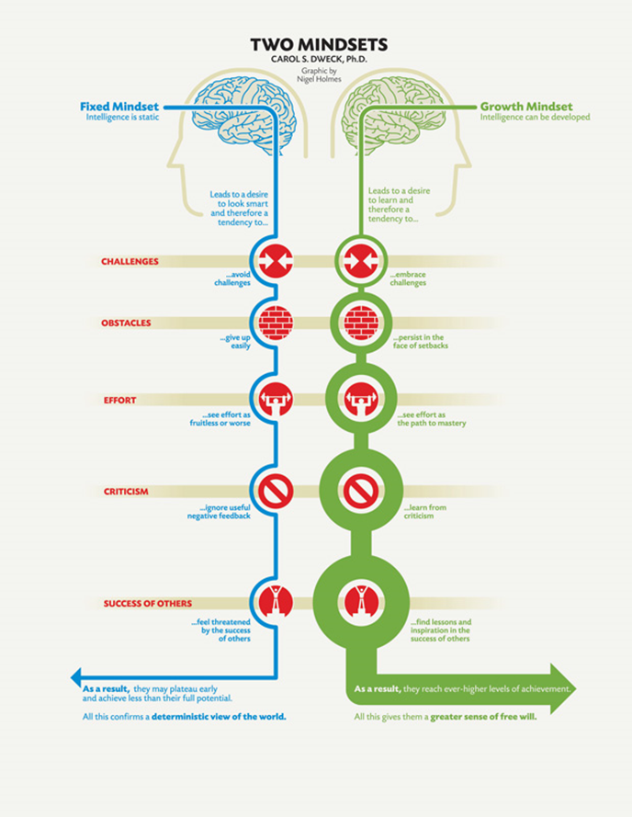

Slide 27
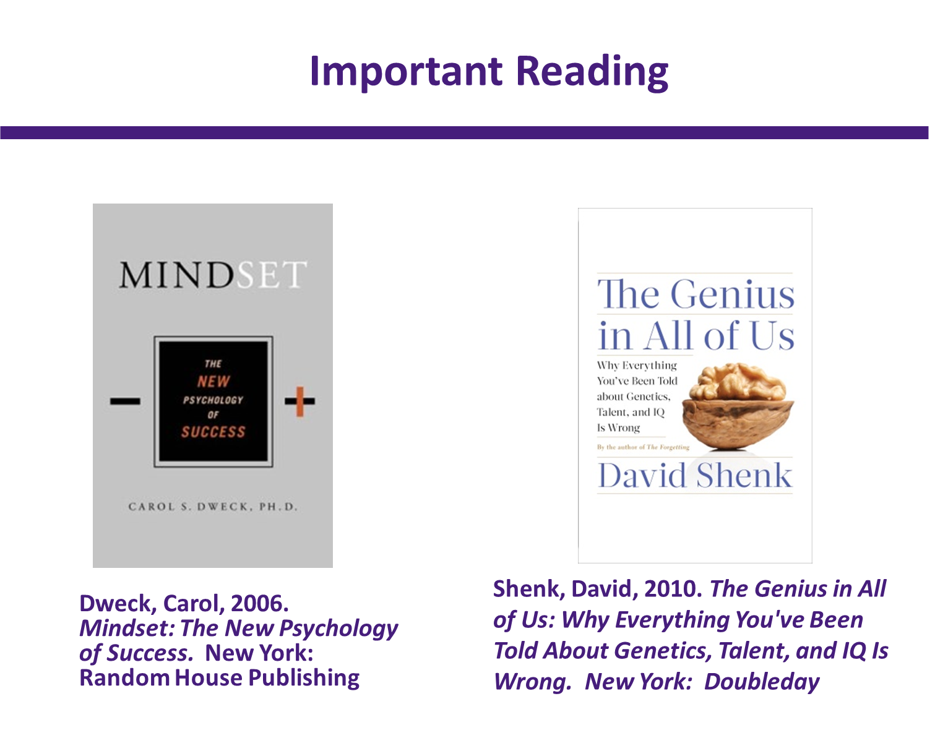

Slide 28
Metacognition: Goal setting & evaluation of progress
Be SMART
Specific, Measurable, Attainable, Realistic, Time-based
Goal: Get a B on exam.
Steps to achieve:
1. Review notes after class each day. Add info.
2. Do homework for 45 minutes each day.
3. On Monday, review notes for previous week.

Slide 29
Metacognition: Goal setting Part 2
Evaluation: Got a 77 on exam.
What worked well?
1. Reviewing notes everyday.
2. Reviewing whole week on Monday.
What didn’t work well?
1. Too hard to do homework everyday.
2. Needed to study theorems & definitions more.
3. Had trouble finding errors.
What to change for next time?
1. Do 1 ½ hours homework T, TH, Sat, Sun.
2. Review boxes and boldface items in text on Mondays.
3. Ask for help on how to find errors.

Slide 30
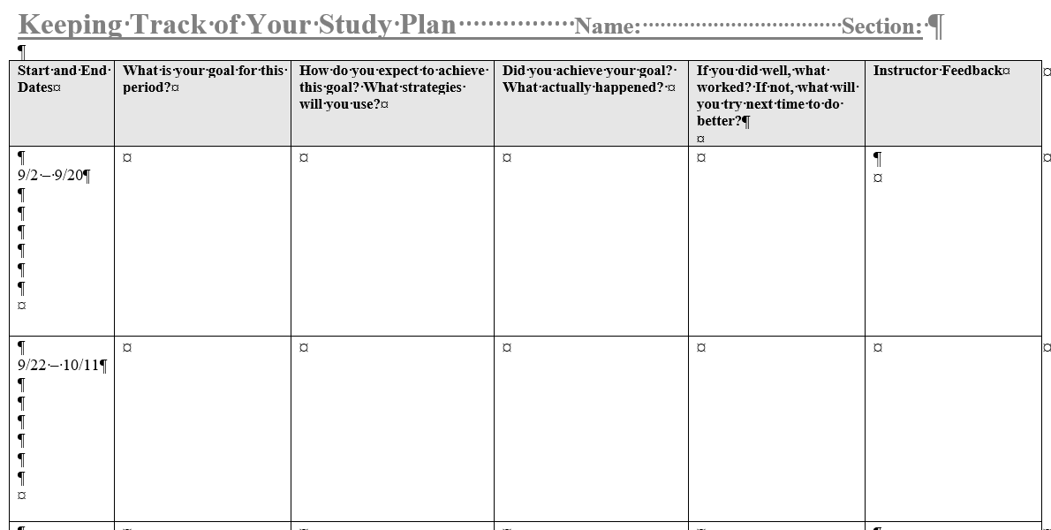
SAMPLE

Slide 31
Metacognition: Goal setting & evaluation of progress
Set reminders of tasks to complete.
Take the number of sections, and plan to study 2-3 per day before the exam. Measure how many days ahead you need to start.
Hold students responsible.

Slide 32
Study skills
Handling distractions
Note taking/studying
The Syllabus & campus resources
Writing up homework
Test anxiety/coping techniques

Slide 33
Study skills: handling distractions
Phones, TV, music, friends
  You may have to prove to them that it distracts their brain & slows them down
    Brain/computer analogy
Desk to the corner

Slide 34
Study skills: Note taking/studying
For the professor:
  Beginning strategy “this is where we are going,” & end strategy “this is what we did today.”
  Always put theorems/definitions in the same place on the same board.
  Use a different color just for theorems/definitions, or underline/box.
  Require students to know simple addition/multiplication/division facts by heart.
  Require students to keep a notebook. (See example.)

Slide 35
Your Class Notebook
You will create and maintain a course notebook. The notebook will be graded on neatness and completeness as part of your homework grade. You should bring your notebook to class every day. It may be randomly checked by the professor at any time, but will always be checked on exam days.
THE STRUCTURE OF THE NOTEBOOK:
The notebook will be in a three ring binder. All papers will be hole-punched and put in the binder. There should be no loose pages.
The first page will be a title page. The title page will include the following:
Your name
Name of the Course and Course Number
Instructor’s Name
Semester and Year
You may want to include a place where I can record grades. Otherwise I will put the grade wherever there is room.
The rest of the notebook will be divided into five sections; each separated by a functional, labeled divider. Here are the sections along with their weight (out of 100 points) toward the overall grade. The title page and overall neatness are worth 10 points.
Section 1 (5 Points): Label the divider “Class Work and Handouts”
The first page in this section should be the syllabus followed by this Notebook handout. If you miss a class, be sure to get any handouts from the professor.
Section 2 (5 Points): Label the divider “Class notes”
Include all your class notes in chronological order.
Section 3 (50 Points): Label the divider “Homework”
This section will hold the assigned homework. Make these assignments as neat and thorough as possible. New homework should be at the front of the homework section so I can access it easily when I grade your notebook.
Section 4 (15 Points): Label the divider “Exams”
Put each exam in order. You will correct each problem missed on every exam. Your corrections should follow the exam on notebook paper or be highlighted on the exam.
Section 5 (15 Points): Label the divider “Glossary”
You will be required to provide a short, “in your own words” definition for every Key Term in the Study Summary at the end of each chapter. Clearly label each new chapter, but do not start each chapter with a new page.
SAMPLE

Slide 36
Study skills: Note taking/studying
For the students:
  Use different colors and/or highlighters for notes (Ex. orange = theorems, blue = definitions, black = examples).
  Indent under major theorems or definitions.
  Underline key concepts.
  Skip 1-3 lines between different concepts/problems/theorems so you can add information later.
  Rework notes as soon after class as possible. Fill in more detail. Mark unclear sections to ask about later.
  When copying example problems, put the math on the left and the reasons (i.e. the Why?) for each line on the right.

Slide 37
Compare and Contrast
Concept #1
Concept #2
How are they similar?
How are they different?

Slide 38

The Study Cycle
4
Reflect
3
Review
Preview before class – Skim the chapter, note headings, boldface words, review summaries, chapter objectives. Questions?
Preview
4
Reflect
Attend class – GO TO CLASS! Answer and ask questions and take meaningful notes.
Attend
Review after class – ASAP after class, read notes, fill in gaps and note any questions.
Review
Study
Study – Repetition is the key. Ask ‘why’, ‘how’, ‘what if’. Use Intense Study Sessions* - 3-5 short study sessions/day. Weekend Review – Read notes/material from the week.
Assess
Assess your Learning – Periodically perform reality checks
Am I using study methods that are effective?
Do I understand the material enough to teach it to others?
Center for Academic Success
B-31 Coates Hall ▪ 225.578.2872 ▪www.cas.lsu.edu

Slide 39
The Study Cycle
Preview before class – Skim the chapter, note headings, boldface words, review summaries, chapter objectives. Questions?
4
Reflect
3
Review
Preview
4
Reflect
Attend
Review
Study
Assess
Center for Academic Success
B-31 Coates Hall ▪ 225.578.2872 ▪www.cas.lsu.edu

Slide 40
The Study Cycle
4
Reflect
3
Review
Preview
4
Reflect
Attend class – GO TO CLASS! Answer and ask questions and take meaningful notes.
Attend
Review
Study
Assess
Center for Academic Success
B-31 Coates Hall ▪ 225.578.2872 ▪www.cas.lsu.edu

Slide 41
The Study Cycle
4
Reflect
3
Review
Preview
4
Reflect
Attend
Review
Review after class – ASAP after class, read notes, fill in gaps and note any questions.
Study
Assess
Center for Academic Success
B-31 Coates Hall ▪ 225.578.2872 ▪www.cas.lsu.edu

Slide 42
The Study Cycle
4
Reflect
3
Review
Preview
4
Reflect
Attend
Review
Study – Repetition is the key. Ask ‘why’, ‘how’, ‘what if’. Use Intense Study Sessions* - 3-5 short study sessions/day. Weekend Review – Read notes/material from the week.
Study
Assess
Center for Academic Success
B-31 Coates Hall ▪ 225.578.2872 ▪www.cas.lsu.edu

Slide 43
The Study Cycle
4
Reflect
3
Review
Preview
4
Reflect
Attend
Review
Study
Assess your Learning – Periodically perform reality checks
Am I using study methods that are effective?
Do I understand the material enough to teach it to others?
Assess
Center for Academic Success
B-31 Coates Hall ▪ 225.578.2872 ▪www.cas.lsu.edu

Slide 44
The Study Cycle
*Intense Study Sessions
1 | Set a Goal | (1-2 min) | Decide what you want to accomplish in your study session
2 | Study with Focus | (30-50 min) | Interact with material- organize, concept map, summarize, process, re-read, fill-in notes, reflect, etc.
3 | Reward Yourself | (10-15 min) | Take a break – call a friend, play a short game, get a snack, etc.
4 | Review | (5 min) | Go over what you just studied
Center for Academic Success
B-31 Coates Hall ▪ 225.578.2872 ▪www.cas.lsu.edu

Slide 45
Top 5 Reasons Students Make an A on exams
1. Did preview/review for every class
2. Did a little of the homework at a time
3. Used the book and did the suggested problems
4. Made flashcards of the information to be memorized
5. Practiced explaining the information to others

Slide 46
Top 5 Reasons students Do Not Make an A on exams
1. Didn’t spend enough time on the material
2. Started the homework too late
3. Didn’t memorize the information I needed to
4. Did not use the book
5. Assumed I understood information that I had read and re-read, but had not applied

Slide 47
Study skills: the syllabus
Students generally don’t know what it is or what it means.
Contract between the professor and the students.
How to read it, what it means.
What are the campus resources (Writing Center, Math Lab, Tutoring, Disability Services) and where are they?
Use a Syllabus/Resources quiz. 90% grade required to take first exam.

Slide 48
Study skills: writing up homework
How to know when to stop
  When you are so frustrated you want to throw something.
  When your mind keeps going in the same circles.
  When the steps you take make the problem more complicated instead of less.
  When you’ve spent 30 minutes on the same problem and haven’t progressed.

Slide 49
Study skills: writing up homework
How to know when to persist
  When you can still think of something else to try.
  When you can keep going.
  When the steps you take make the problem less complicated instead of more.
  When it’s been less than 30 minutes.

Slide 50
Study skills: writing up homework
When you know it’s wrong; error finding strategies
  Put the entire piece of paper aside and start on a fresh sheet. Do NOT look at what you did before.
  Explain your steps OUT LOUD to your dog/sibling/cat.
  Ask a friend/classmate to look it over.
  Send a pdf of your work to your professor, asking for help.

Slide 51
Homework Guidelines
All assignments are to be submitted through Blackboard as a .pdf, .doc, or .docx file, or handed in at the beginning of class on the day it is due. Assignments are due before midnight. Copiers in the library will convert to pdf files, as will scanners in the Open Computer Lab.
I have also included a folder of free cell phone apps that will convert a photo to a pdf file, which you can then upload to your computer to upload to Blackboard. It usually doesn’t work as well to upload directly from the phone to Blackboard. I generally send my phone pdfs to Dropbox (also free), then upload them to Blackboard, and that works great.
No late assignments. The submission locations will disappear shortly after midnight, so do not be late. Better an incomplete, than a 0.
With the exception of word problems, copy the problem. For word problems, draw and label a picture or graph, as applicable.
Show all your work. Flat answers receive flat zero credit. No steps should be omitted, and it should be clear to a lower level student.
Work all problems on blank printer paper.
Every problem starts on the left margin. Highlight every problem number or circle it. Please do not staple over this number; it is trés annoying. In fact, don’t staple at all.
Draw a horizontal bar between problems, and leave a gap of ½ “.
Keep all problems in number order.
Turn in inside a translucent, folder with a Velcro flap. I will not accept homework not in the folder.
You may not double column your work. If you do, you’ll be rewriting it for half credit.
The smaller you write, the crabbier I get. And you make more mistakes, more to the point.
You may write on the back, but keep a ½ ” margin all around.
Circle or highlight your final solution.
Try to keep it neat and legible.
Your goal is to PROVE to me you know how to solve the problems, not just to solve them.
It should look like this:
1. Find the derivative of f(x)=3x⁴+sinx³+52.
Blah Blah Blah
x=12x3+3x2cosx3
Or like this:
2. Find the derivative of f(x)=3x⁴+sinx³+52.
Blah Blah Blah
x=12x³+3x²cosx³
SAMPLE

Slide 52
Study skills: Test anxiety coping techniques
Feet flat on floor, hands on thighs, palms down, close eyes.
Deep breathing like a 5-year old—belly out, belly in.
Visualize a warm calm place, cookies baking, perhaps a grandparent
Use a mantra: “I can do this.” “I can do this.” over and over, slowly and with conviction.
Shaking in bathroom prior to exam.

Slide 53
Study skills: Test anxiety coping techniques
Foods to avoid:
  ▪Chocolate ▪Donuts ▪Caffeine beverages
Don’t change your routine!
  Go to bed at the same time.
  Get up at the same time.
  Eat the same foods.
  Don’t start/stop any bad habits now.
  Don’t break up with your significant other now.

Slide 54
Problem solving & resourcefulness
The General:
  Every complaint is an opportunity for problem solving!
    No time for homework? What are you going to do about that?
    Stuck on a problem? Go to the Math Lab, email a classmate, use Office Hours.
  Model it out loud.
  Let them struggle through it. Be quiet and wait.
  Let them brainstorm together.

Slide 55






Problem solving & resourcefulness
The Specific:
Left side: The math
Right side: The why
The problem
Distributive Property
Subtraction of like terms
Move 3x by subtraction
Move 21 by addition
$$3x+7=2\left(4x−9\right)−3$$
$$3x+7=8x−18−3$$
$$3x+7=8x−21$$
$$3x−3x+7=8x−3x−21$$
$$7=5x−21$$
$$7+21=5x−21+21$$

Slide 56


Image retrieved from https://www.google.com/imgres?imgurl=http%3A%2F%2Fwww.grittogreat.com%2Fwp-content%2Fuploads%2F2015%2F05%2Fslide1.grit_.jpg&imgrefurl=http%3A%2F%2Fwww.grittogreat.com%2F&docid=PQSdVklWjNxk2M&tbnid=LQKOLcaF9puSMM%3A&vet=10ahUKEwjq8ZSD8KrXAhUQzWMKHUO0AdQQMwjAASgTMBM..i&w=960&h=425&bih=652&biw=1412&q=grit%20images&ved=0ahUKEwjq8ZSD8KrXAhUQzWMKHUO0AdQQMwjAASgTMBM&iact=mrc&uact=8
Image retrieved from https://holykaw.alltop.com/wp-content/uploads/2014/03/Fotolia_44881707_Subscription_XXL.jpg

Slide 57
Angela Duckworth: The Grit Scale
Here are a number of statements that may or may not apply to you. There are no right or wrong answers, so just answer honestly, considering how you compare to most people. At the end, you’ll get a score that reflects how passionate and persevering you see yourself to be. For each, choose from:
Very much like me Mostly like me Somewhat like me Not much like me Not like me at all
1. New ideas and projects sometimes distract me from previous ones.
2. Setbacks don’t discourage me. I don’t give up easily.
3. I often set a goal but later choose to pursue a different one.
4. I am a hard worker.
Duckworth, A. (2017). Grit Scale [Webpage]. Retrieved from https://angeladuckworth.com/grit-scale/

Slide 58
Angela Duckworth: The Grit Scale cont’d
For each, choose from:
Very much like me Mostly like me Somewhat like me Not much like me Not like me at all
5. I have difficulty maintaining my focus on projects that take more than a few months to complete.
6. I finish whatever I begin.
7. My interests change from year to year.
8. I am diligent. I never give up.
9. I have been obsessed with a certain idea or project for a short time but later lost interest.
10. I have overcome setbacks to conquer an important challenge.
Duckworth, A. (2017). Grit Scale [Webpage]. Retrieved from https://angeladuckworth.com/grit-scale/

Slide 59
How do we instill grit?
Read about grit. Assign short articles.
Talk about grit.
Share examples and photos of grit.
Develop a “growth mindset.” (Coming later.)
Reframe problems by giving perspective.
Live grittily. Randy Pausch’s Last Lecture.
Foster a safe, accepting environment that encourages grit.
Help students develop intentional habits.
Acknowledge the sacrifice grit requires.
Discuss when you need grit and when you need to quit.

Slide 60
Communication & interpersonal skills
Students in corequisite classes are the ones who like to hide and/or sit in the back of the room. …
…So don’t let them.

Slide 61
Communication & Interpersonal skills
Critical Interpersonal skills:
  Talk to the professor
  Email the professor
  Ask questions
  Listen actively
  Maintain eye contact
  Learn to shake hands

Slide 62
Sample email template
Dear Professor Name, my name is your name here, and I am in your name of class, that meets at time of class on day(s) of class.
I need help on problem number # on page # in the textbook. The difficulty I am having is state your very specific, detailed issue here.
I have to miss class on date you have to miss due to give brief reason here. I noticed from the schedule that we have a missed assignment name on that day. Can I take the missed assignment name early on day at time?
Thank you for your help.
Your first and last name here.
Your student ID here

Slide 63
Communication & Interpersonal skills
Collaboration
  Building a study group
    Low-income students are much less likely (almost twice as much) to work together in groups.
  The value of working at the board.
    Have the whole class up at once.
    Not isolated.
    Feel less conspicuous.
    Roaming professor.
    Help other groups when your work is approved.

Slide 64
Communication & Interpersonal skills
Professionalism:
  Where you sit matters.
  How you dress matters.
  How you speak matters.
  How you write matters.
  (Front or middle, no sides or back.)
  (Not a rock concert or rave.)
  (No *$#%!, be respectful, no “Hey miss!”)
  (Clearly, legibly, proper grammar)
  You have 1/10 of one second.

Slide 65
Useful websites for students
How to study sites:
  www.howtostudy.org
  www.vark-learn.com
  www.drearlbloch.com
  http://academic.pg.cc.md.us/~wpeirce/MCCCTR/metacognition.htm
Math content sites:
  www.khanacademy.org
  www.HippoCampus.org
  http://tutorial.math.lamar.edu/
  http://mathforum.org/
  http://www.profrobbob.com/
  https://education.ti.com/

Slide 66
Just for fun websites
https://plus.maths.org/content/
https://ed.ted.com/lessons/the-unexpected-math-behind-van-gogh-s-starry-night-natalya-st-clair
https://youtu.be/lA6hE7NFIK0
https://youtu.be/23I5GS4JiDg
https://youtu.be/N-7tcTIrers

Slide 67
How to turn cell phone photos into pdf files
Android
  From Google PlayStore: https://play.google.com/store/apps/details?id=com.stoik.mdscanlite
  http://www.pdfmate.com/3-pdf-converter-for-android-mobile-phones.html
i-Phones
  https://itunes.apple.com/us/app/camscanner-free-pdf-document/id388627783?mt=8
Windows phones
  http://www.windowsphone.com/en-us/store/app/camscanner/d991ee36-dc78-41e1-9406-0943f13c70fb

Slide 68
References
Adams, C. J. (November 13, 2012). Focus on: College readiness: ‘Soft skills’ pushed as part of college readiness. Education Week 32(12), 1, 14. Retrieved November 5, 2017 from https://www.edweek.org/ew/articles/2012/11/14/12softskills_ep.h32.html
Complete College America. (2017). Corequisite remediation: Spanning the completion divide: Breakthrough results fulfilling the promise of college access for underprepared students [Webpage]. Retrieved November 2, 2017 from http://completecollege.org/spanningthedivide/#footer
Coutts, N. (2014). Metacognition: Thinking about your thinking. In RediQuest. Retrieved from http://www.rediquest.com/metacognition/
Duckworth, A. (2017). Grit Scale [Webpage]. Retrieved from https://angeladuckworth.com/grit-scale/
Dweck, C. (2008). Mindset: The new psychology of success. New York, NY: Ballantine Books.
Holmes, B. (May 12, 2014). Hone the top 5 soft skills every college student needs [Webpage]. U.S. News & World Report. Retrieved November 5, 2017 from https://www.usnews.com/education/blogs/college-admissions-playbook/2014/05/12/hone-the-top-5-soft-skills-every-college-student-needs
Odafe, V. U. (2007). Teaching and learning mathematics: Student reflection adds a new dimension. In D.K. Pugalee, A. Rogerson, & A. Schinck (Eds.) Proceedings from 9th International Conference: Mathematics Education in a Global Community (pp. 486-490). The Mathematics Education into the 21st Century Project & The University of North Carolina Charlotte. Charlotte, NC. Retrieved from http://math.unipa.it/~grim/21_project/21_charlotte_OdafePaperEdit.pdf
Pearson. (2017). Math study skills resources: Incorporate study skills into your class and help your students succeed! [Webpage]. Retrieved November 2, 2017 from https://www.pearsonhighered.com/alanbass/instructor-resources.html
Perkins, K. K., & Wieman, C. E. (2005). The surprising impact of seat location on student performance. Physics Teacher, 43 (January), 30-33.
Stires, L. (1980). Classroom seating location, student grades, and attitudes: Environment or self-selection? Environment and Behavior, 12, 241-254. doi: 10.1177/0013916580122008
Venator, J., & Reeves, R. V. (March 18, 2015). Social mobility memos: Building the soft skills for success. The Brookings Institution. [webpage] Retrieved November 5, 2017 from https://www.brookings.edu/blog/social-mobility-memos/2015/03/18/building-the-soft-skills-for-success/

Slide 69
Count the Vowels in 30 seconds
How accurate are you?

Slide 70
Dollar Bill
Dice
Tricycle
Four-leaf Clover
Hand
Six-Pack
Seven-Up
Octopus
Cat Lives
Bowling Pins
Football Team
Dozen Eggs
Unlucky Friday
Valentine’s Day
Quarter Hour

Slide 71
NOW How many words or phrases
do you remember?

Slide 72
Look at the words again.
How are they arranged? Is there a pattern?

Slide 73
Dollar Bill
Dice
Tricycle
Four-leaf Clover
Hand
Six-Pack
Seven-Up
Octopus
Cat Lives
Bowling Pins
Football Team
Dozen Eggs
Unlucky Friday
Valentine’s Day
Quarter Hour

Slide 74
Try again.
How many words or phrases do you remember now?

Slide 75
What were two major differences between the first attempt
and the second attempt?

Slide 76
We knew what the task was.
We knew how the information was organized.

