Slide 1

Building an Inclusive Classroom Online and F2F:
Addressing Math Anxiety and
Using Computing Tools
Melvin Cacayorin

Slide 2

Calculus 2
Projects to Alleviate Math Anxiety
Melvin Cacayorin

Slide 3
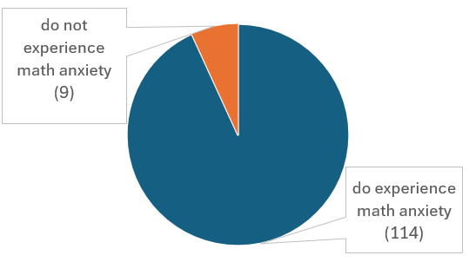
How many experience math anxiety?
Many enjoy math
Many are confident about their abilities

Slide 4
What triggers math anxiety?
Test and quizzes
Time pressure

Slide 5
What does math anxiety look like?
Feeling tense
Difficulty concentrating
Racing heart
Negative thoughts
Avoiding class

Slide 6
Coping strategies
Brain breaks
Tutoring
Attending office hours
Fidgeting

Slide 7

APPROACH
Projects replace half of quizzes
Surveys to gather thoughts on anxiety
Pre- and Post-Assessments to bookend the class experience

Slide 8

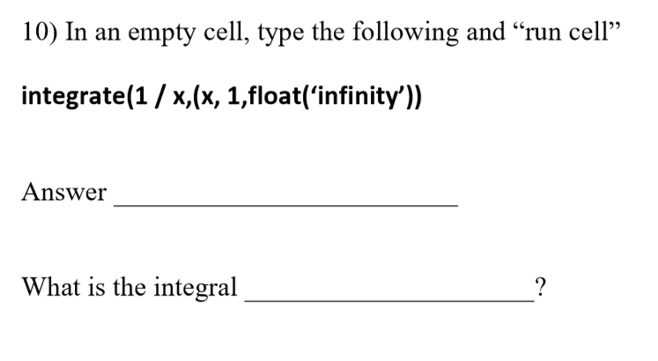

Slide 9
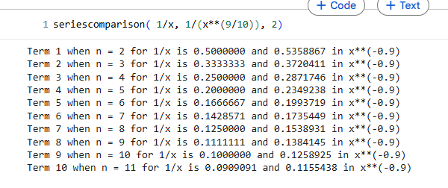
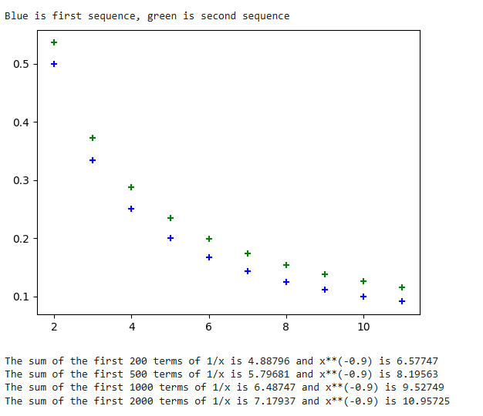

Slide 10

Initial Concerns
Working with Python
Introversion

Slide 11

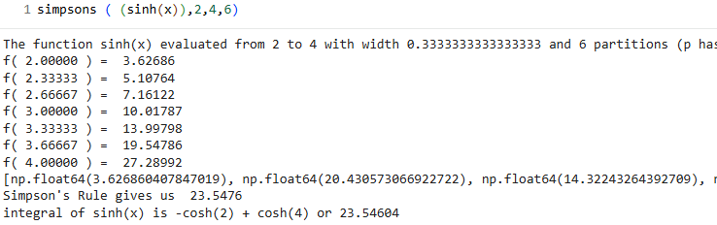
EXAMPLES OF WORK

Slide 12
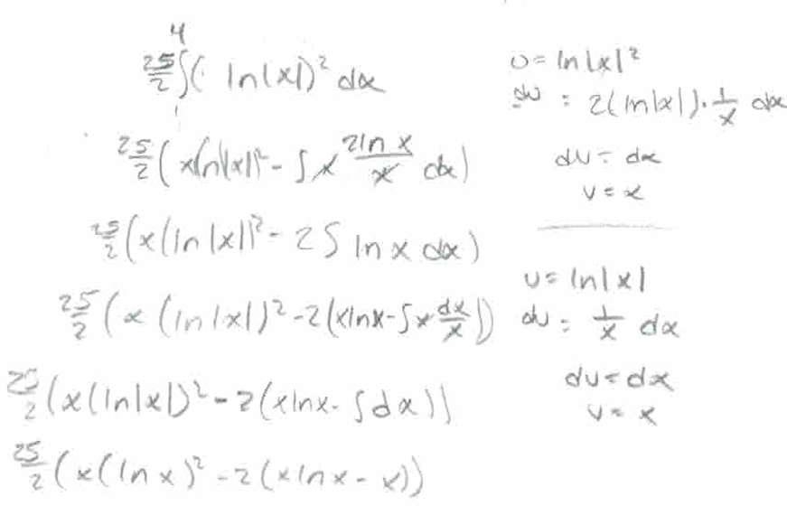
EXAMPLES OF WORK

Slide 13

RESULTS

Slide 14
How Do They Think Projects Help?
Less time pressure

Slide 15
Effectiveness of Replacing Quizzes with Projects?
Majority (66-75%) thought Somewhat or Very Effective

Slide 16
CONCLUSIONS

Slide 17

CONCLUSIONS & CHANGES TO MAKE IN FUTURE
Increased community
Technical skills with computing tools
Students learned to handle anxiety

Slide 18
CONCLUSIONS & CHANGES TO MAKE IN FUTURE
Bottom line
Projects helped students succeed

Slide 19
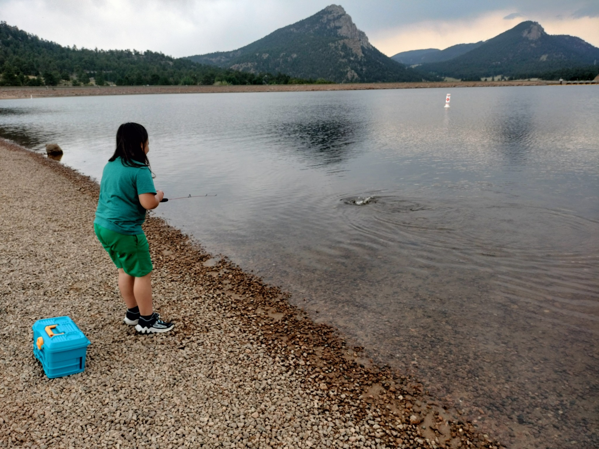


Slide 20
What else have I learned about math anxiety

Slide 21
Where did students get math anxiety come from?
It’s a learned response

Slide 22
What are the root causes of math anxiety?
past experience
terminology
fear of failure
ambiguity

Slide 23
What type of math do students have most anxiety with?
fractions
laws of exponents
probability
factoring
slope of a line
geometry
word problems

Slide 24
What is your math personality?
quantitative
qualitative

Slide 25
What is the biggest reason for non-success in math?
proper pre-requisite skills

Slide 26
How do you help?
careful planning prior to entering school
smart choices
preparation
discipline
learning from mistakes

Slide 27
Computing Tools

Slide 28
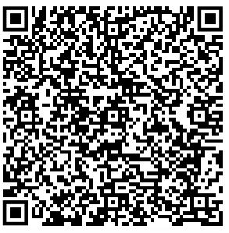

Python
Use Google Colabs if you have a Google account.
Use Red Rocks Data Science server by pointing browser to math01.rrcc.edu. Find Cacayorin Hub and hit “Launch Hub 11”, login is kershaw_clayton with
password “gododgers”.

Slide 29
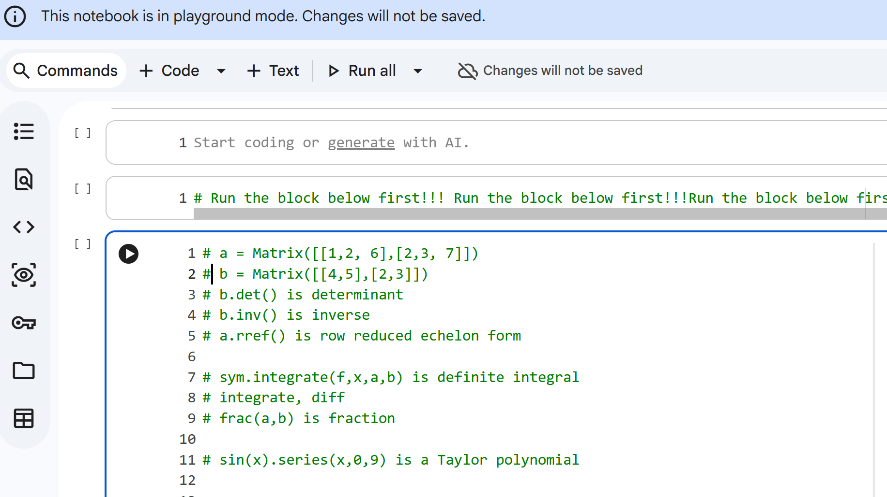

Python
In Google Colabs scroll down, run is black arrow. Run the big block first!

Slide 30
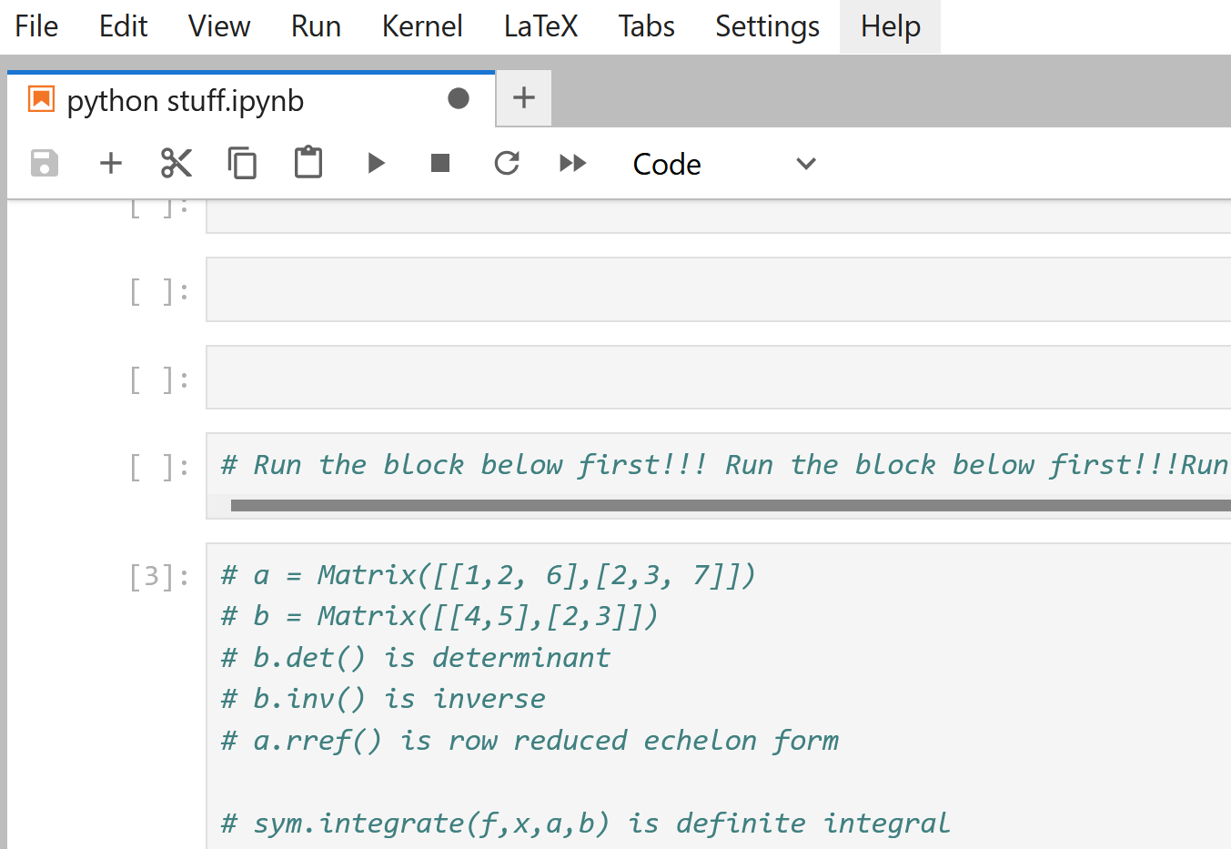


Python
In RRCC Data Science server, run is black arrow. Run the big block first!

Slide 31
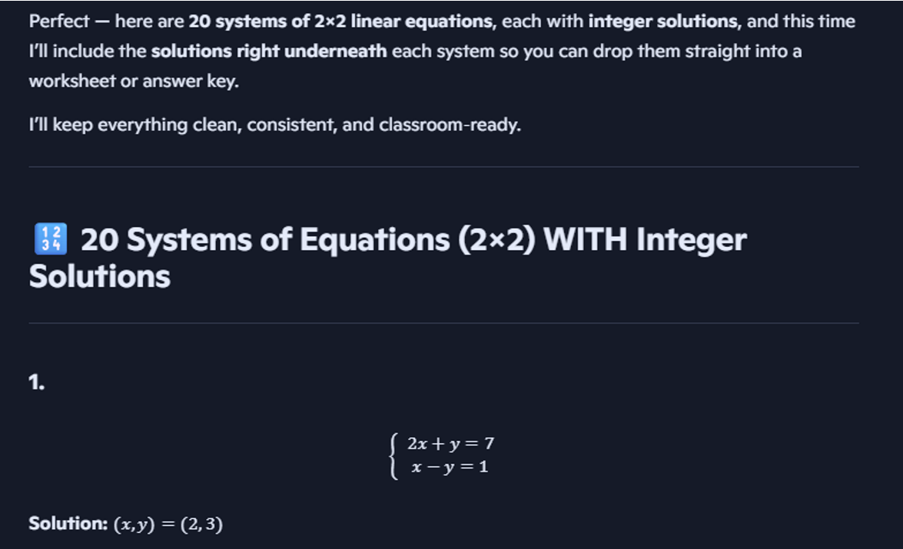

Slide 32
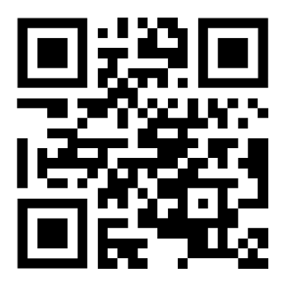

Number-Q
Point your browser to number-q.com.
This is Daniel
Trinkaus. →

Slide 33

Reach out!
Melvin Cacayorin
melvin.cacayorin@rrcc.edu

